Slide 1
OOP: Encapsulation ,Abstraction & Polymorphism

Slide 2
What is Encapsulation
Described as a protective barrier that prevents the code and data being randomly accessed by other code defined outside the class.
Is the technique of making the fields in a class private and providing access to the fields via public methods.
Is also referred to as data hiding.

Slide 3
Benefit of Encapsulation
The fields of a class can be made read-only or write-only.
A class can have total control over what is stored in its fields.
The users of a class do not know how the class stores its data. A class can change the data type of a field, and users of the class do not need to change any of their code.

Slide 4
Implement Encapsulation
Keep instance variables private.
Make public accessor methods.
For the methods, use the JavaBeans naming convention of set<someProperty> and get<someProperty>.

Slide 5
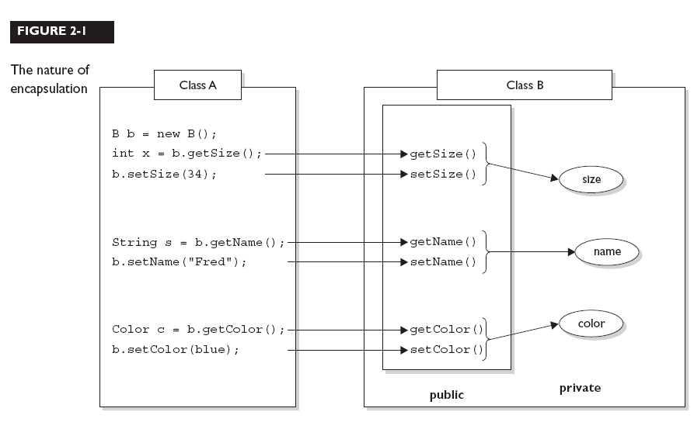
Implement Encapsulation

Slide 6
Abstraction
Is to hide actual implementation of an object from the external world that would use the object.
Implementation hiding.
Ex : stack , queue.

Slide 7
Final keyword
Final variable can be assigned only once.
Final variable that is not initialized must be initialized in the constructors.
Final methods cannot be overridden.
Final classes cannot be extended. Restricting inheritance!

Slide 8
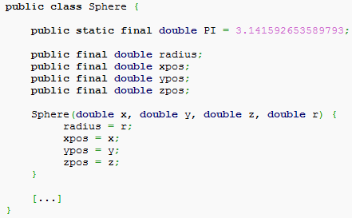
Final keyword cont,

Slide 9
Static keyword
Static means one per class.
Static variable is called a “class variable”.
All instances share the same copy of the variable.
A class variable can be accessed directly with the class, without the need to create a instance
Static method can be used without having to create a object first.

Slide 10
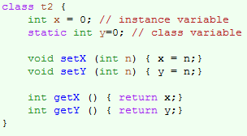
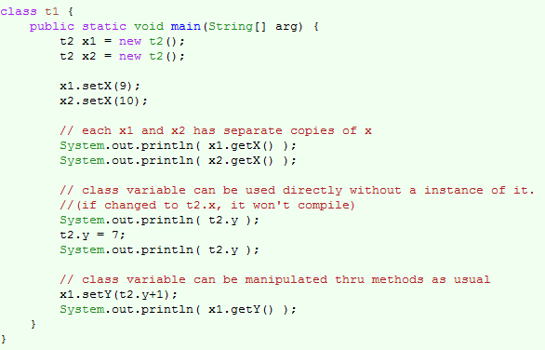

Slide 11
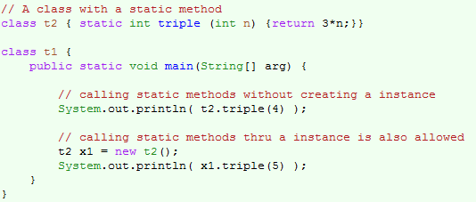
Static method

Slide 12
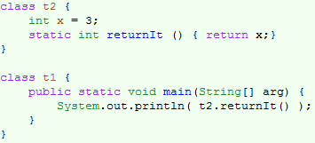
Static method
Note : Static Methods Cannot Access Non-Static Variables

Slide 13
The rules for overriding
The argument list must exactly match that of the overridden method. (If they don't match, you can end up with an overloaded).
The return type must be the same as, the return type declared in the original overridden method in the superclass.
The access level can't be more restrictive than the overridden method's.
The access level CAN be less restrictive than that of the overridden method.

Slide 14
The rules for overriding
You cannot override a method marked final.
You cannot override a method marked static.
If a method can't be inherited, you cannot override it

Slide 15
Polymorphism
Polymorphism : is the ability of an object to take on many forms.
The most common use of polymorphism in OOP occurs when
parent class reference is used to refer to a child class object.
public class Animal{}
public class Deer extends Animal {}
Deer d = new Deer();
Animal a = d;

Slide 16
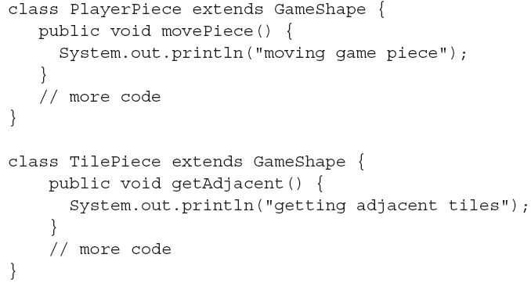
Polymorphism

Slide 17
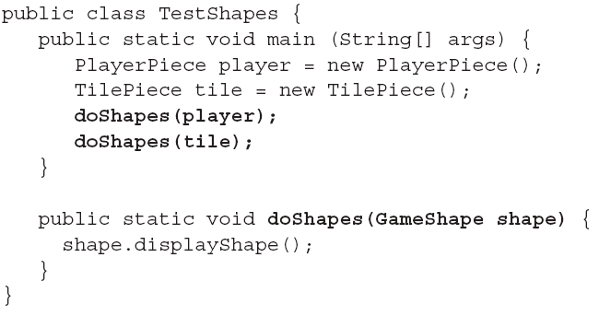
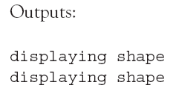
Polymorphism
Note :The method can invoke any method of GameShape, without any concern for the actual runtime class type of the object passed to the method

Slide 18
Polymorphism benefits
Allow extensibility
Allow Simplicity

Slide 19
Static and dynamic binding
Static binding:
Which Method will be invocated will be determined at compile time.
Dynamic binding:
Which Method will be invocated will be determined at runtime time.

Slide 20
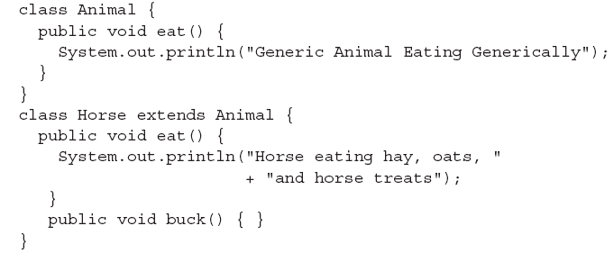
Static and dynamic binding
What happen when I make thing like this?
Animal a=new Horse();
a.eat();//will call which one
a.buck();

Slide 21
Static and dynamic binding
Note :
Method invocations allowed by the compiler are based solely on the declared type of the reference, regardless of the object type
Which overridden version of the method to call (in other words, from which class in the inheritance tree) is decided at runtime based on object type

Slide 22
Static and dynamic binding
Compiler error

Slide 23
Thank You

